Slide 1
AI Assisted app for farmers
2210701202 K Ragavendar
210701203 V Raghav
210701215 M Rohit

Slide 2
Abstract
An inventive web program called FarmAI Companion is using artificial intelligence to transform farming methods.
The app provides tailored suggestions for resource management, agribusiness practices, and crop selection.
Using climatic data, past crop performance, and local soil characteristics, the program uses machine learning algorithms to provide farmers recommendations for crops that do well in their particular settings.

Slide 3
Existing System
Challenges faced in the existing system are,

Slide 4
Suboptimal Yield
Limited access to data driven insights and modern agricultural practices contributes to suboptimal crop yields.
Resource Inefficiency
Inefficient use of resources such as water, fertilizers, and pesticides due to a lack of precise recommendations and monitoring.
Vulnerability to Weather Changes
Farmers face challenges in adapting to rapidly changing weather patterns, impacting crop growth and harvest cycles.

Slide 5
Pest and Disease Outbreaks
Manual identification of pests and diseases often leads to delayed responses, resulting in potential crop losses.
Limited Adoption of Technology:
The lack of user friendly , technology driven solutions hinders the adoption of advanced farming practices.

Slide 6
Proposed System
What we are implementing here

Slide 7
1. AI Driven Crop recommendation 2. Providing appropriate farming season 3. Crop yielding 4. Amount of Fertilizers and pesticides to be used

Slide 8
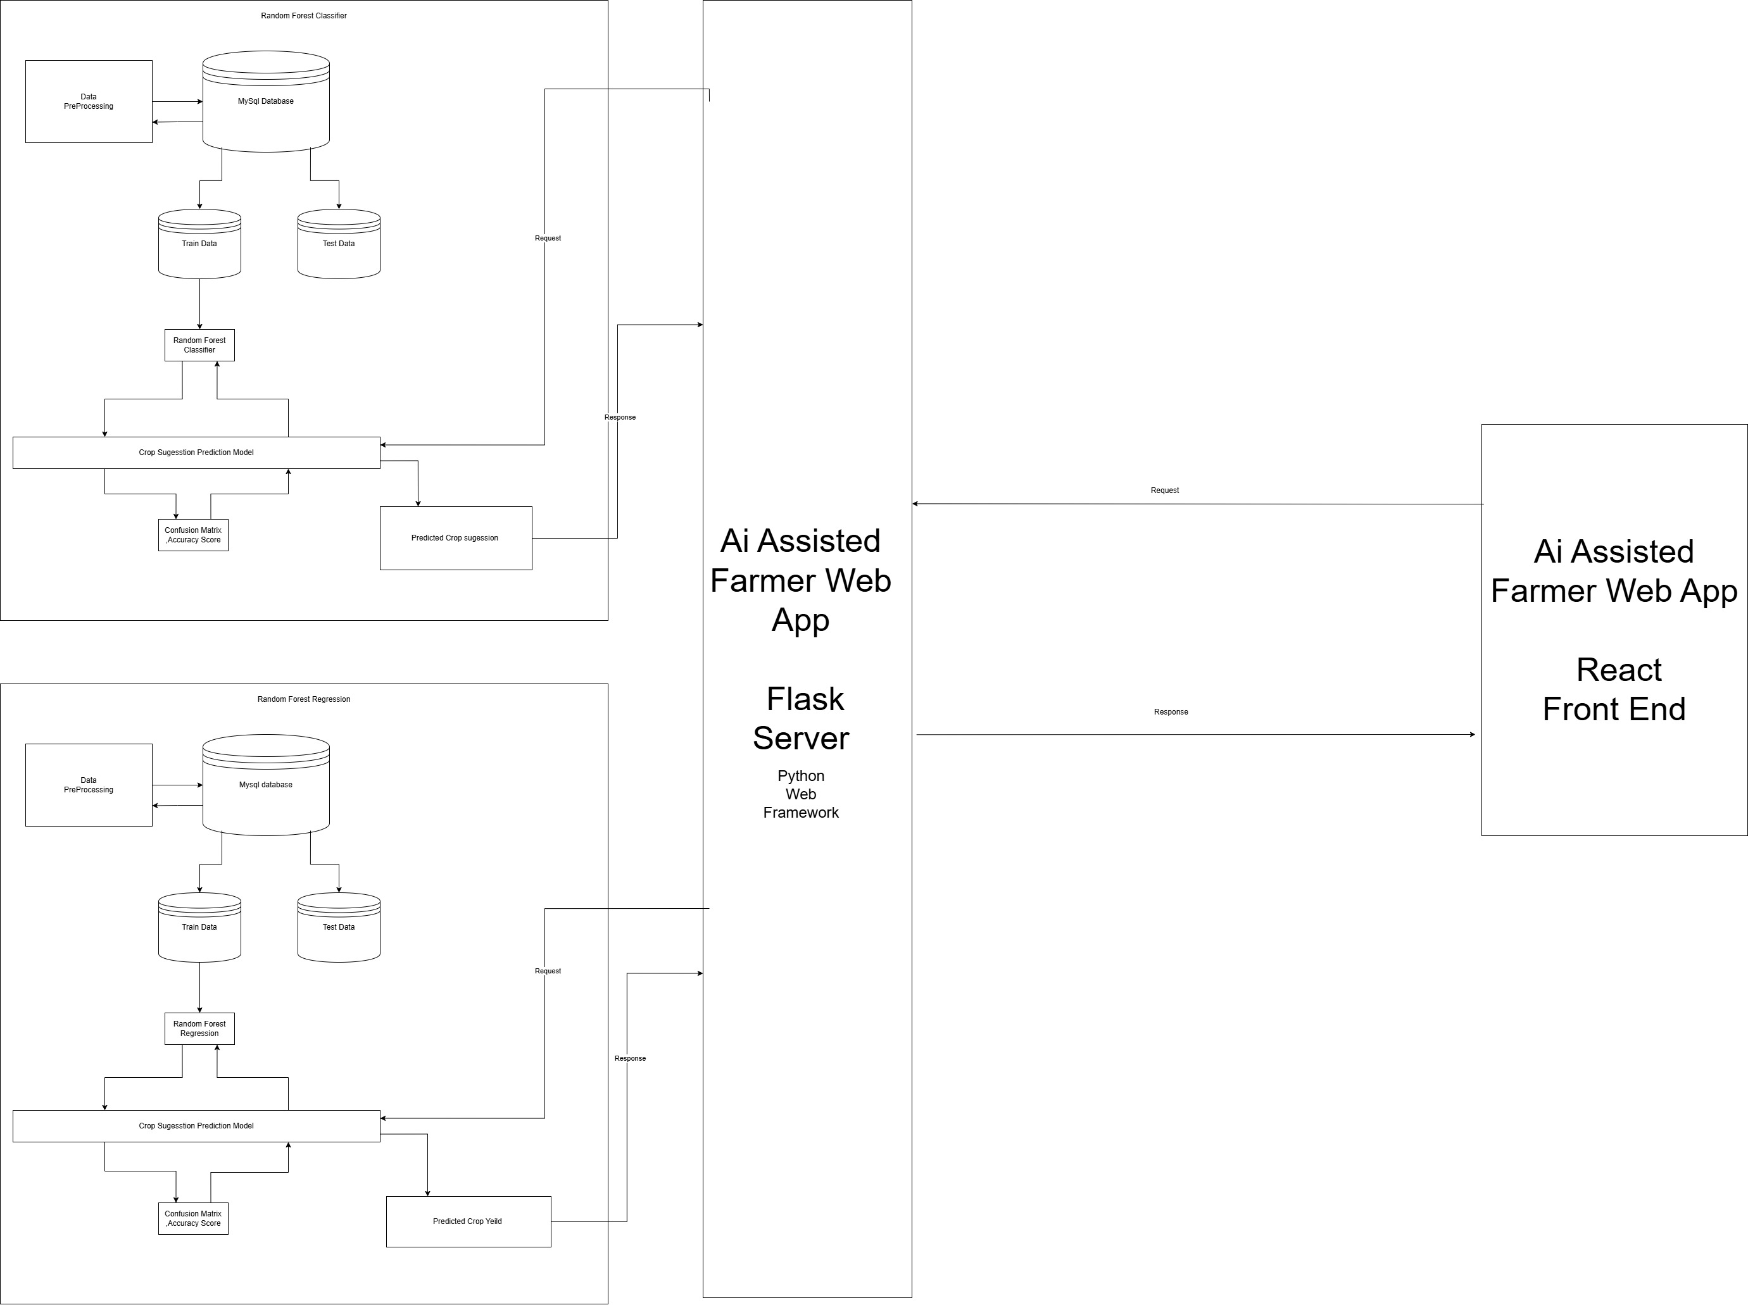
System Architecture

Slide 9
Modules and its Description
Crop Recommendation Module
By using random forest classifier we will recommend the crop .
Because in recommendation we have to identify the crop which is suitable to the farmer’s situation .
No need to predict

Slide 10
Fertilizers ,Pesticides,Yield Prediction Module
By using random forest regression we will predict the amount of fertilizers, pesticides to be needed in the future.
And Crop Yield prediction is also done here.

Slide 11
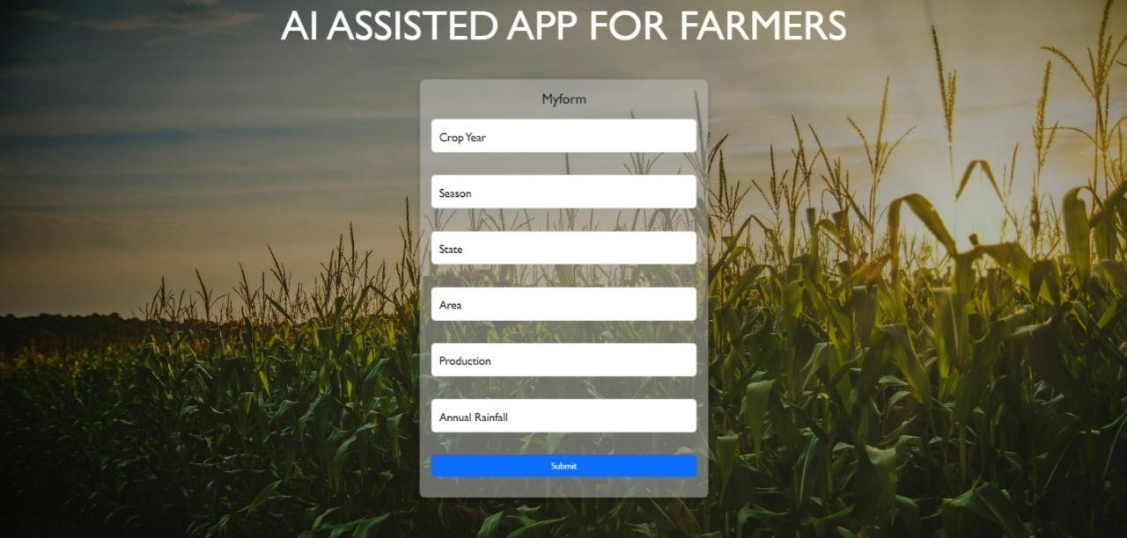
Result and Discussion
OUTPUT
UI OUTPUT
User Interface by which farmer should enter the needed particulars to predict the crop yield,farming practices

Slide 12
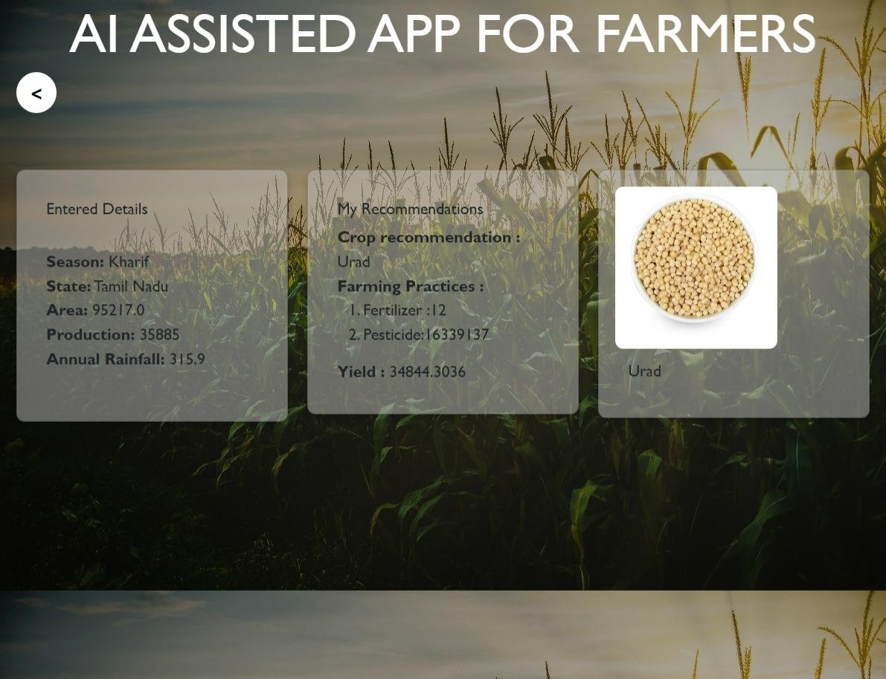
OUTPUT GENERATED BY OUR ML MODEL
ML MODEL OUTPUT
The model will make an analysis and give the output .And this output is very helpful for the farmer to make decision in the upcoming season.

Slide 13
Conclusion
Through the application of artificial intelligence, real-time data analytics, and community engagement, the initiative seeks to improve productivity, empower farmers with tailored insights, and advance sustainable farming methods.
By utilizing precision farming methods, optimum crop selection, the initiative has the potential to boost resistance to climate-related issues, enhance resource efficiency, and enhance agricultural yields.

Slide 14
Future Enhancements
Use more complex AI algorithm
Integration of IOT Devices
Utilize Blockchain technology
Enhanced Language support

Slide 15
THANK YOU

